Slide 1
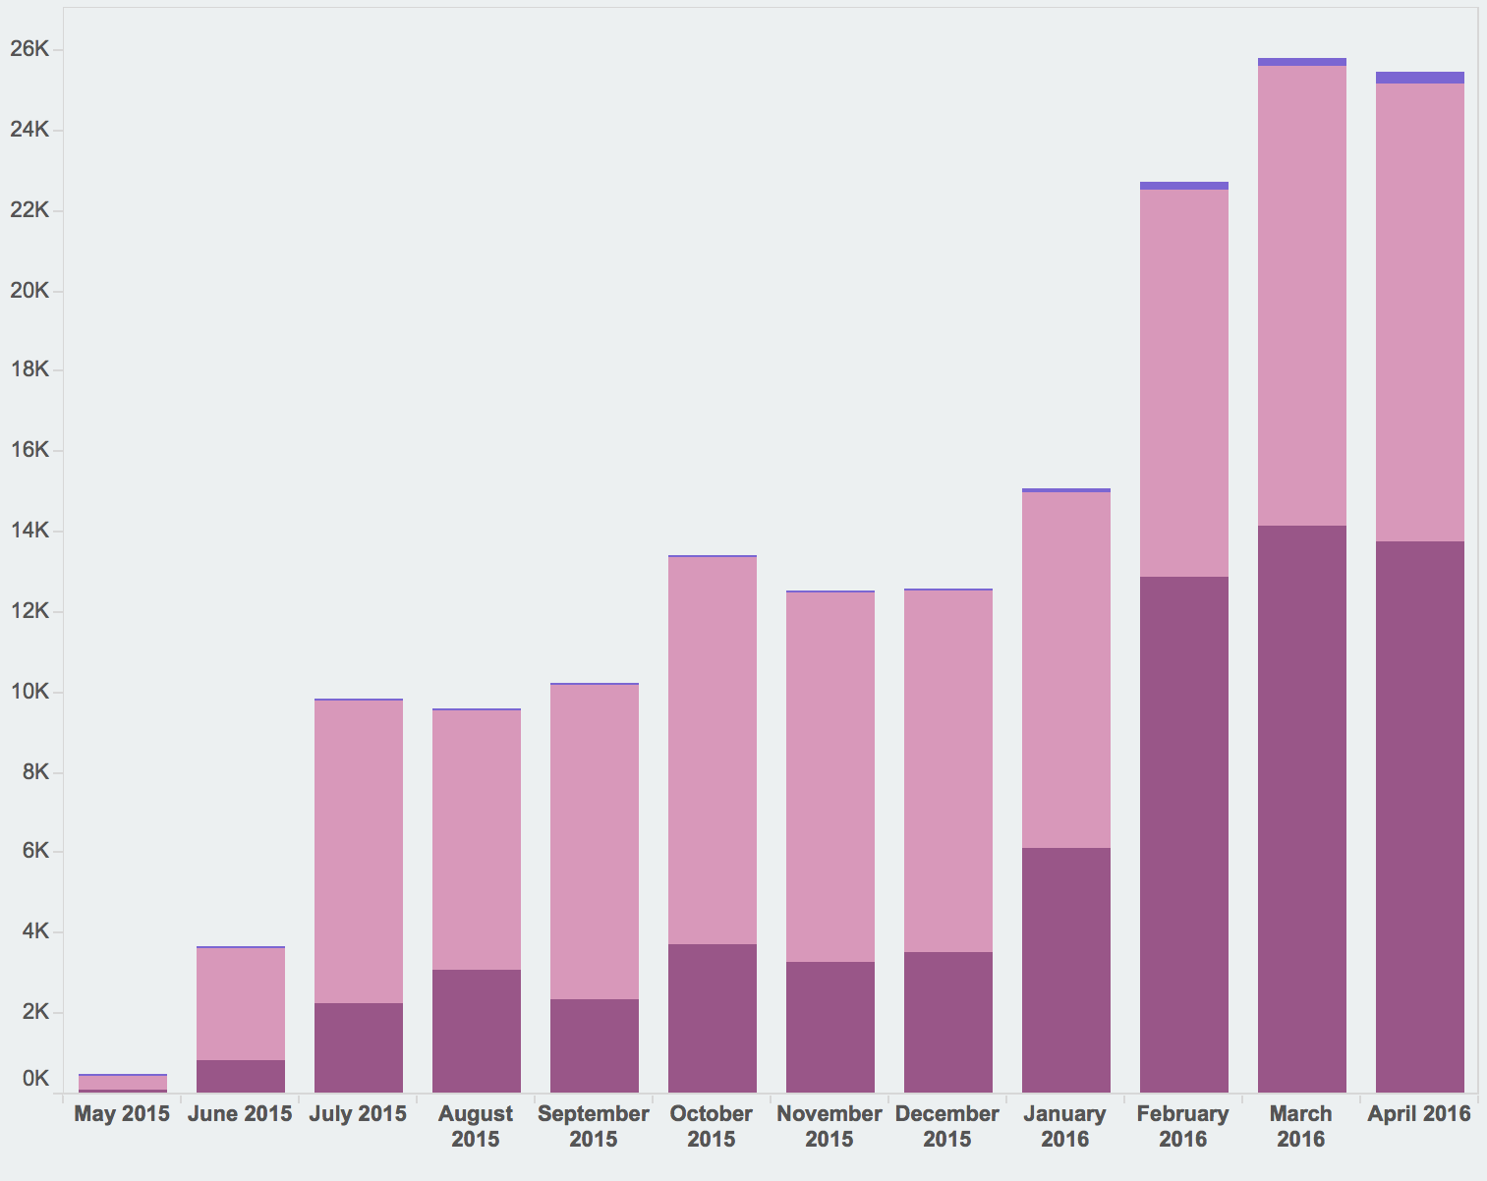
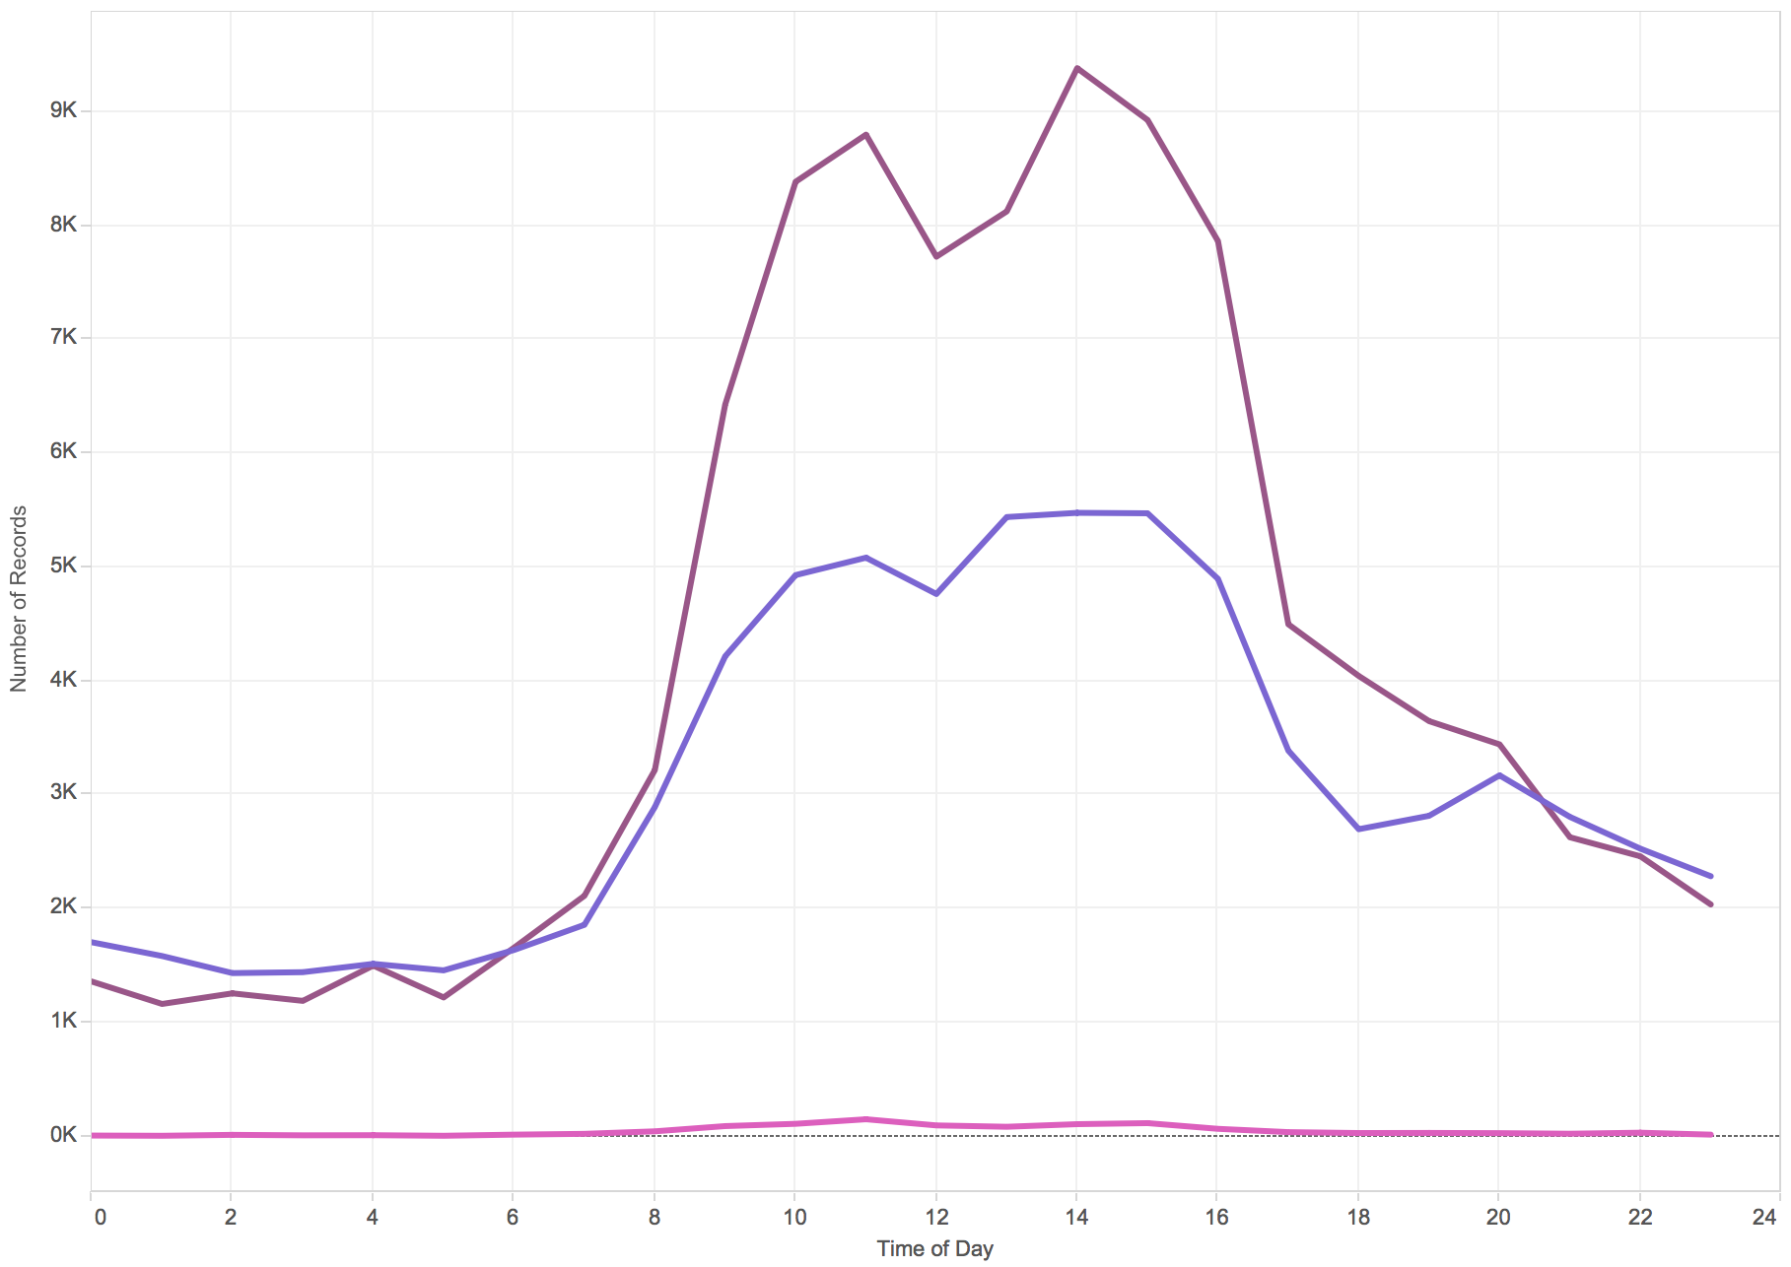
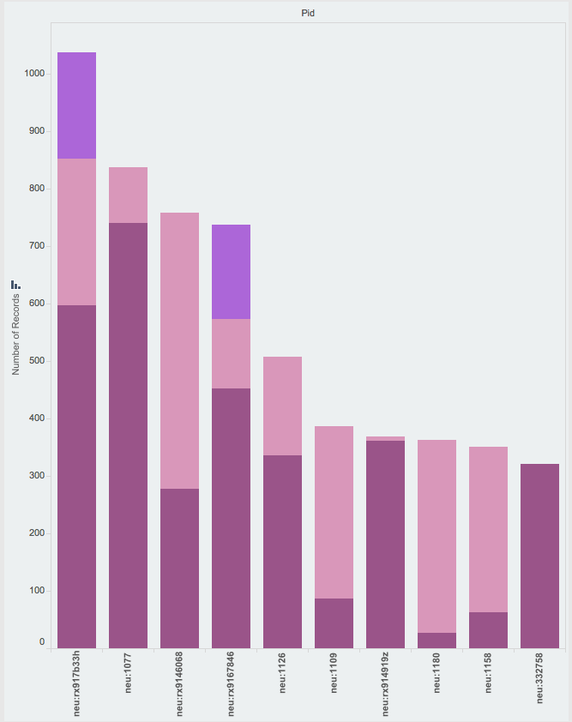

Measuring Genuine Use of Repository Content
at Northeastern University
Northeastern University Library
Sarah Sweeney sj.sweeney@neu.edu
repository.library.northeastern.edu
Usage Statistics in the Digital Repository Service
Regardless of the collection method, statistics gathered about repository usage are utilized by content owners to measure the use and impact of repository materials and to measure use of the repository as a whole. Therefore, it is vital that the usage data is gathered in a way that reflects genuine repository use and can be defended as an accurate representation of the value of the repository.
A seemingly endless number of bots exist to crawl publicly available repository content for harvesting and indexing, which helps increase discovery of repository content, but can also greatly inflate usage statistics. Although users tend to prefer higher numbers regardless of the consumer, we want to be able to defend the statistics we are gathering and declare them to be a genuine record of the use of our content.
Not All Traffic is Equal
Early on in the DRS development process we decided not to leave our statistics in the hands of Google Analytics. While Google Analytics does a lot of valuable tracking, we can't easily differentiate genuine user traffic from bot, crawler, or harvester traffic. To that end, we decided to limit what counts as use by disregarding counts generated by bots and other large consumers of our content. We record all impressions (views, downloads, and streams), and we also record the agent or referrer responsible for the impression. We actively filter out agents that are known to be bots (or other agents that may not reflect genuine human use), which allows us to present accurate usage counts to users and enables us to more precisely measure repository activity.
April 2016 DRS Activity: Humans vs. Bots
Bots
Humans
One Year of DRS Activity
Views, downloads, and streams per month.
Filtering
When the impressions table is processed, the user agent value is compared against the known bots list.
If a user agent matches a known bot, the impression’s public value is set to "false" and filtered out of the statistics that are displayed to users in the interface.
Jobs are run nightly and weekly.
Top Five Referrers
May 2015-May 2016
Based on files views
The Impressions Table
When the impressions table is processed, the user agent value is compared against the known bots list. If a user agent matches a known bot, the impression’s public value is set to "false" and filtered out of the statistics that are displayed to users in the interface.
ID | PID | session_id | action | ip_address | referrer | status | user_agent | public | created_at | updated_at | processed
184159 | neu:190034 | 5f79a9934… | view | 108.20.51… | direct | COMPLETE | Mozilla/5.0 (iPad; CPU OS… | TRUE | 5/21/15 9:41 | 1/22/16 1:58 | TRUE
184181 | neu:190034 | a745a871e… | view | 129.10.107… | direct | COMPLETE | Mozilla/5.0 (Windows NT 6.1… | TRUE | 5/21/15 12:32 | 1/22/16 1:58 | TRUE
184182 | neu:182058 | a745a8715… | download | 129.10.107… | direct | COMPLETE | Mozilla/5.0 (Windows NT 6.1… | TRUE | 5/21/15 12:33 | 1/22/16 1:58 | TRUE
184183 | neu:1302 | e5d85e81e… | view | 129.10.106… | https://repository… | COMPLETE | Mozilla/5.0 (Windows NT 6.1… | TRUE | 5/21/15 12:42 | 1/22/16 1:58 | TRUE
Important Processing Values
Status: Used to indicate that the impression status is complete, which to allow us to exclude items that are queued for download (incomplete).
Public: Impressions recorded by bots will be set to False. All other traffic is True.
Processed: True indicates that the impression has been passed through the bot blacklist. False indicates the impression has not been reviewed, and is likely less than 24 hours old.
Bots
Humans
Ignored Agents
*archive*, *bot*, *crawl*, *curl*, *java*, *lynx*, *nutch*, *scrape*, *scrapy*, *slurp*, *spider*
Popular Items
Views, downloads, streams displayed per hour
Next Steps
Process more statistics to improve our process
Regular processing/reviewing of agents list for new bots
Aggregated statistics for Curator's Interface
Google Indexing Workbench statistics
Daily Activity Per Hour
Views, downloads, streams displayed per hour. Helps inform our decision about when to schedule deploys. (Best time, Saturday at 3am. Most reasonable time, Wednesdays, 7am.
Conclusion
Measuring impact accurately is a difficult task, as is being able to confidently defend how measurements are recorded. There are several possible methods to measure use, but not all methods are transparent enough to explain to users exactly how use is being counted.
Learn More
For more information about the DRS visit
dsg.neu.edu/resources/drs or
github.com/NEU-Libraries/cerberus

Slide 2
Measuring Genuine Use of Repository Content
at Northeastern University
Northeastern University Libraries
Sarah Sweeney sj.sweeney@neu.edu
repository.library.northeastern.edu
Usage Statistics in the Digital Repository Service
Regardless of the collection method, statistics gathered about repository usage are utilized by content owners to measure the use and impact of repository materials and to measure use of the repository as a whole. Therefore, it is vital that the usage data is gathered in a way that reflects genuine repository use and can be defended as an accurate representation of the value of the repository.
A seemingly endless number of bots exist to crawl publicly available repository content for harvesting and indexing, which helps increase discovery of repository content, but can also greatly inflate usage statistics. Although users tend to prefer higher numbers regardless of the consumer, we want to be able to defend the statistics we are gathering and declare them to be a genuine record of the use of our content.
Not All Traffic is Equal
Early on in the DRS development process we decided not to leave our statistics in the hands of Google Analytics. While Google Analytics does a lot of valuable tracking, we can't easily differentiate genuine user traffic from bot, crawler, or harvester traffic. To that end, we decided to limit what counts as use by disregarding counts generated by bots and other large consumers of our content. We record all impressions (views, downloads, and streams), and we also record the agent or referrer responsible for the impression. We actively filter out agents that are known to be bots (or other agents that may not reflect genuine human use), which allows us to present accurate usage counts to users and enables us to more precisely measure repository activity.
April 2016 DRS Activity: Humans vs. Bots
Bots
Humans
One Year of DRS Activity
Views, downloads, and streams per month.
Filtering
When the impressions table is processed, the user agent value is compared against the known bots list.
If a user agent matches a known bot, the impression’s public value is set to "false" and filtered out of the statistics that are displayed to users in the interface.
Jobs are run nightly and weekly.
Top Five Referrers
May 2015-May 2016
Based on files views
The Impressions Table
When the impressions table is processed, the user agent value is compared against the known bots list. If a user agent matches a known bot, the impression’s public value is set to "false" and filtered out of the statistics that are displayed to users in the interface.
ID | PID | session_id | action | ip_address | referrer | status | user_agent | public | created_at | updated_at | processed
184159 | neu:190034 | 5f79a9934… | view | 108.20.51… | direct | COMPLETE | Mozilla/5.0 (iPad; CPU OS… | TRUE | 5/21/15 9:41 | 1/22/16 1:58 | TRUE
184181 | neu:190034 | a745a871e… | view | 129.10.107… | direct | COMPLETE | Mozilla/5.0 (Windows NT 6.1… | TRUE | 5/21/15 12:32 | 1/22/16 1:58 | TRUE
184182 | neu:182058 | a745a8715… | download | 129.10.107… | direct | COMPLETE | Mozilla/5.0 (Windows NT 6.1… | TRUE | 5/21/15 12:33 | 1/22/16 1:58 | TRUE
184183 | neu:1302 | e5d85e81e… | view | 129.10.106… | https://repository… | COMPLETE | Mozilla/5.0 (Windows NT 6.1… | TRUE | 5/21/15 12:42 | 1/22/16 1:58 | TRUE
Ignored Agents
Stored Values
*archive*, *bot*, *crawl*, *curl*, *java*, *lynx*,
*nutch*, *scrape*, *scrapy*, *slurp*, *spider*
Column | Value
id | SQL table ID
pid | Core file or content object ID
session_id | Unique session ID
action | View, download, or stream
ip_address | Acting user agent IP
referrer | User agent origin
status | Impression state
user_agent | Entity that triggered the impression
public | User agent’s classification
created_at | Impression datestamp
updated_at | Entry update datestamp
processed | The user_agent's evaluation status
Popular Items
Views, downloads, streams displayed per hour
Daily Activity Per Hour
Views, downloads, streams displayed per hour. Helps inform our decision about when to schedule deploys. (Best time, Saturday at 3am. Most reasonable time, Wednesdays, 7am.
Next Steps
Process more statistics to improve our process
Regular processing/reviewing of agents list for new bots
Aggregated statistics for Curator's Interface
Google Indexing Workbench statistics
Conclusion
Measuring impact accurately is a difficult task, as is being able to confidently defend how measurements are recorded. There are several possible methods to measure use, but not all methods are transparent enough to explain to users exactly how use is being counted.
Learn More
For more information about the DRS visit
dsg.neu.edu/resources/drs or
github.com/NEU-Libraries/cerberus

Slide 3
Title
Northeastern University Library
Sarah Sweeney sj.sweeney@neu.edu
repository.library.northeastern.edu
Heading 1
Paragraph text
The community framework has not just neatly organized repository content according to the existing Northeastern college and department structure, it has made it easier for the system to leverage the relationships between objects to enhance the discoverability of scholarly content in the repository.
Heading 2
Valuable repository content can be discovered through multiple search and browse options.
Communities and collections are easily organized according to an existing authoritative framework.
The repository structure follows a model that is quickly understood by Northeastern users.
Learn More
For more information about the DRS visit
dsg.neu.edu/resources/drs or
github.com/NEU-Libraries/cerberus

